Slide 1
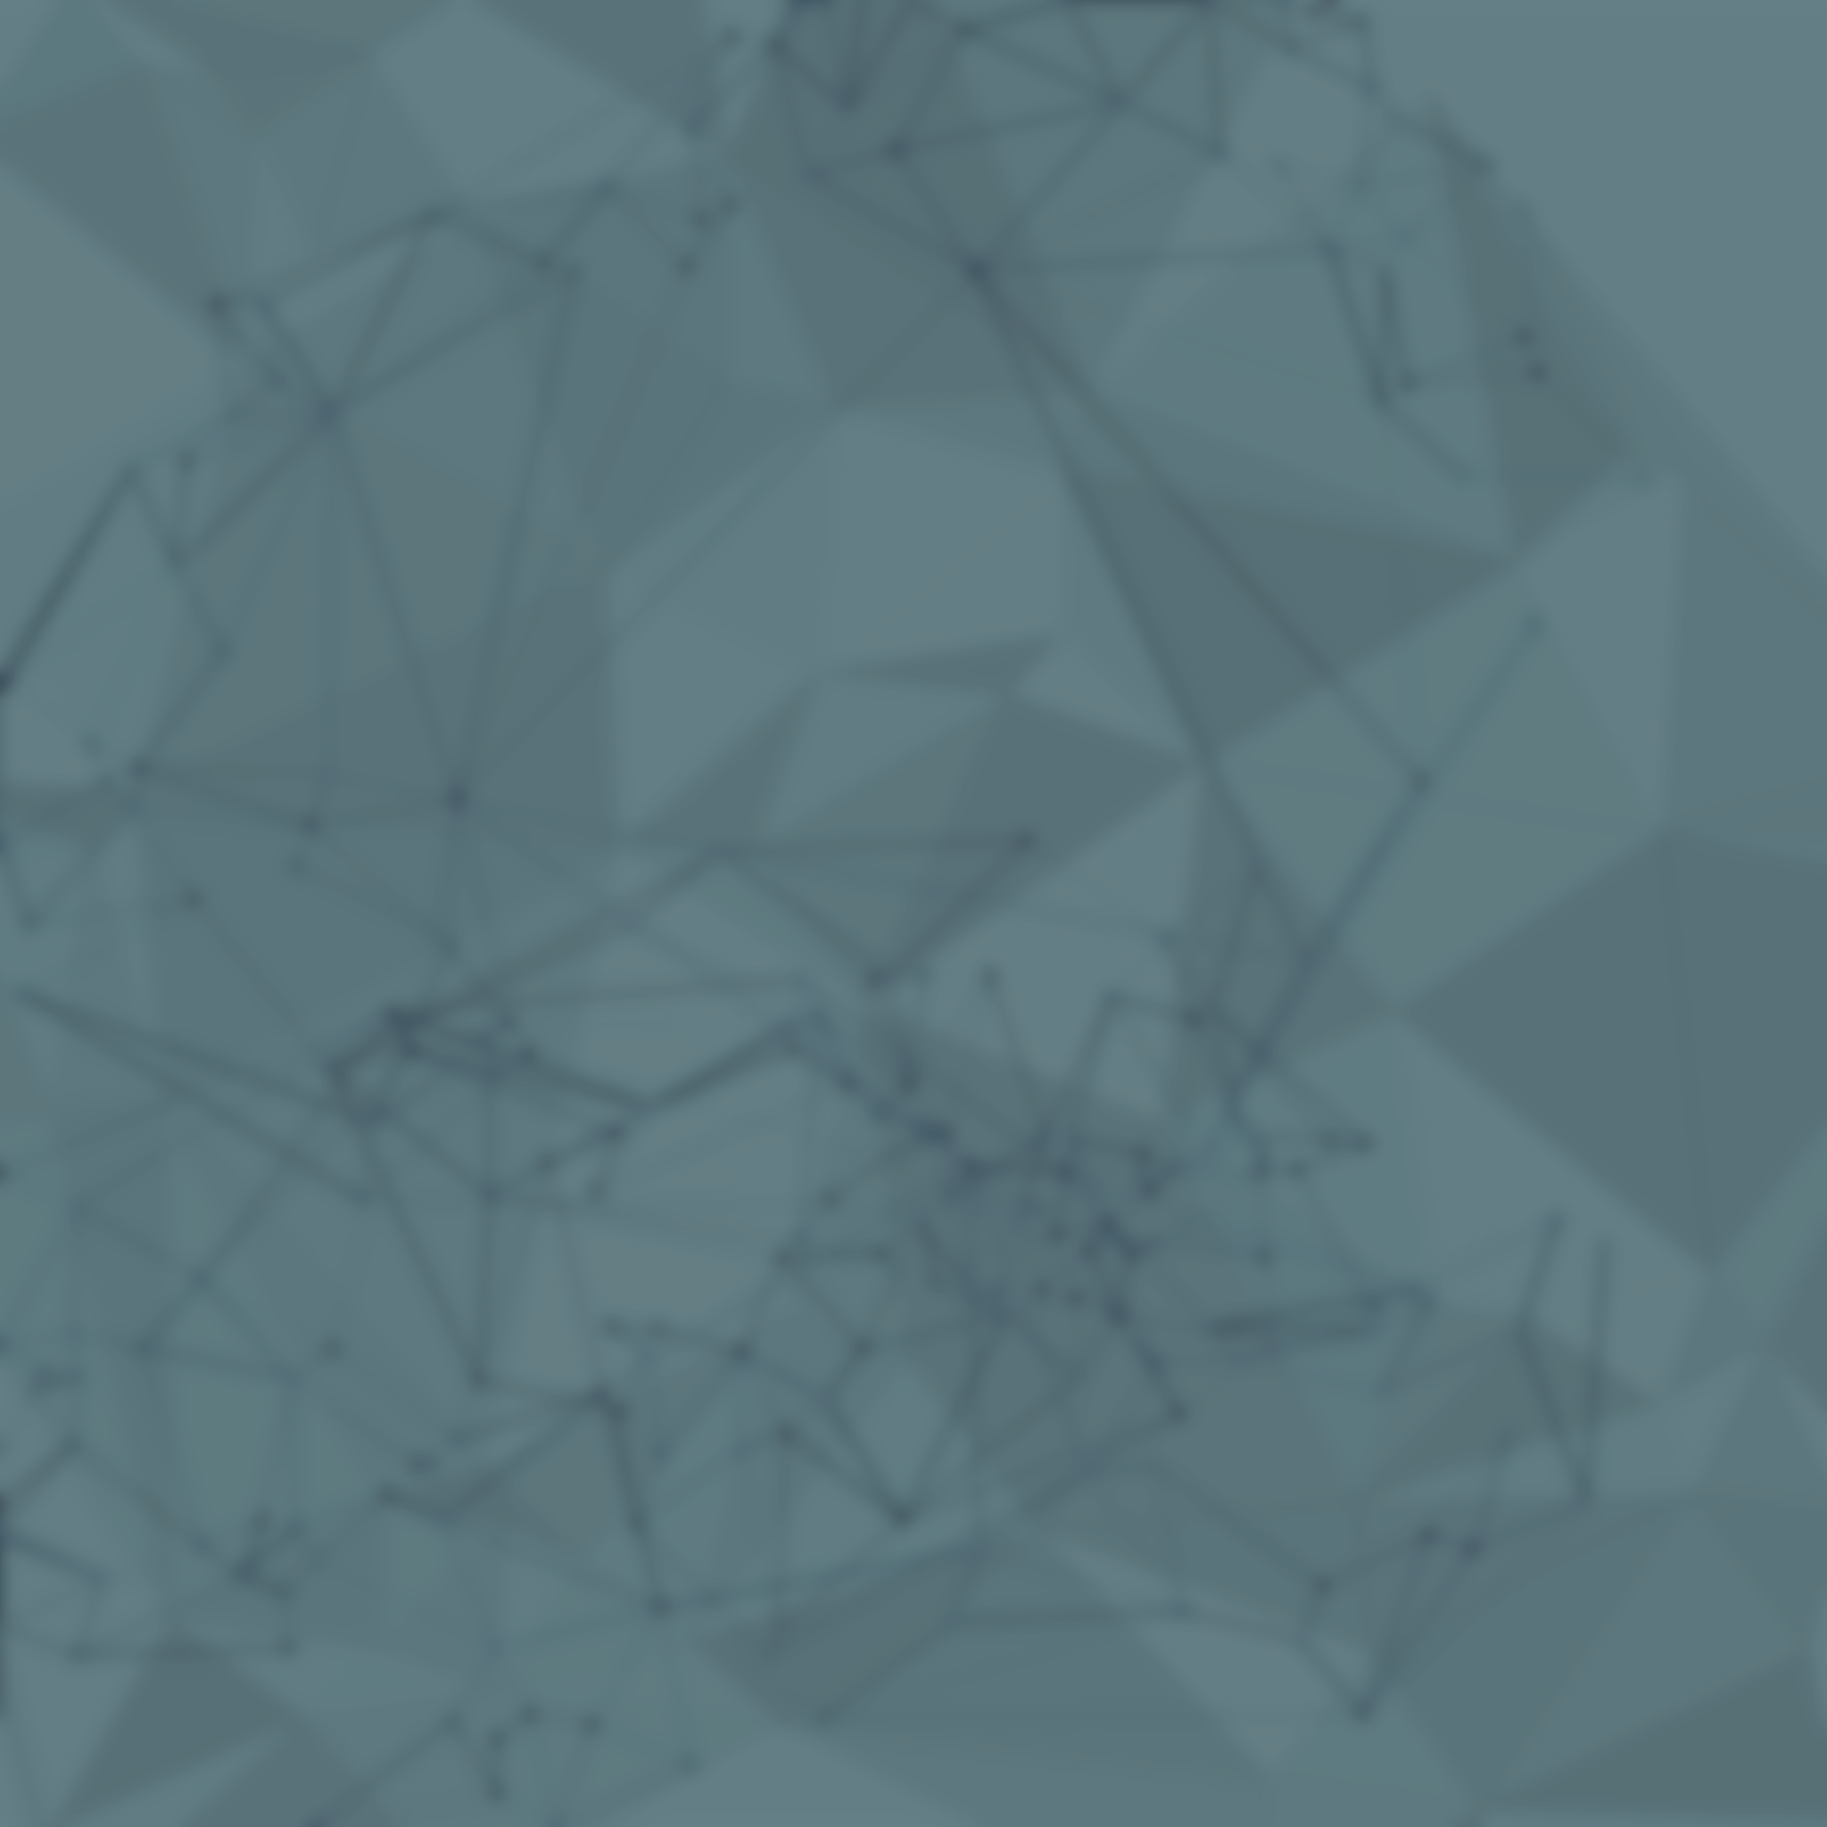
Novel Mode: GNN-MARL System
Overview
Intelligent Agent Learning
Agents dynamically learn optimal rescue strategies through graph-based reinforcement learning, adapting to terrain Altitude and mission complexity.
Graph Neural Networks: Model agent relationships and spatial dependencies in rescue operations
Multi-Agent RL: Each agent learns from experience using Actor-Critic networks with experience replay
Dynamic Adaptation: Real-time policy updates based on rescue success rates and environmental feedback
Graph Neural Network Multi-Agent Reinforcement Learning for Adaptive Mountain Rescue Operations

Slide 2
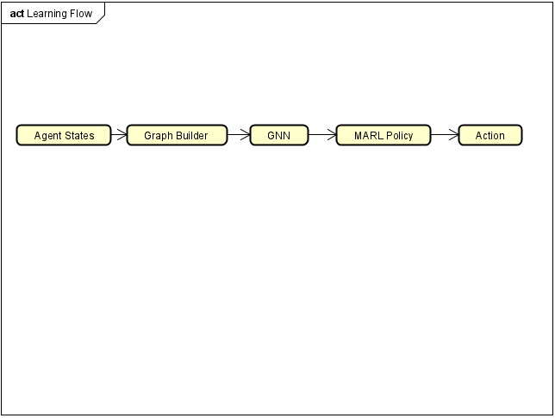
Multi-Agent Concepts Applied
Learning Architecture Flow
Cooperative Learning: Agents learn coordinated policies through shared graph representations while maintaining individual decision networks
Distributed Learning: Each agent type (robots, drones) maintains separate Actor-Critic networks, enabling specialized skill development
Graph-based Communication: Spatial and mission relationships modelled as dynamic graphs, replacing traditional message passing
Emergent Behaviour: Complex coordination patterns emerge from simple learned interaction rules learned through Reinforcement Learning
Node Features: [position, battery, state, urgency, terrain_cost] Edge Features: [distance, type_interaction, mission_relevance] Reward Function: R = rescue_bonus + efficiency_penalty + coordination_bonus

Slide 3
Structural Elements
Behavioural Dynamics
GraphBuilder Component: New module dynamically constructs agent interaction graphs based on spatial proximity and mission relevance
GNN Architecture: 4-layer Graph Attention Network processes 64-dimensional node features and 32-dimensional edge features
MARL Agents: Individual Actor-Critic networks for each agent type with separate action spaces
Experience Replay: Shared memory buffer for efficient learning from past rescue scenarios
Reward System: Multi-objective reward function balancing rescue success, operational efficiency, and coordination quality
Aspect | Extended Mode | Novel GNN-MARL
Decision Making | Fixed state machines | Learned adaptive policies
Coordination | Message broadcasting | Graph attention mechanism
Adaptation | Static rule-based | Continuous learning
Performance | Consistent baseline | Improving over time
Scalability | O(n²) messaging | O(n) graph processing
Learning Dynamics: Agents update policies every step using temporal difference learning from rescue outcomes. Exploration-exploitation balance via ε-greedy with decay (1.0 → 0.01).
Emergent Coordination: Complex rescue patterns emerge without explicit programming through reinforcement learning
Adaptive Strategies: Agents learn terrain-specific navigation and resource allocation strategies

